Slide 1
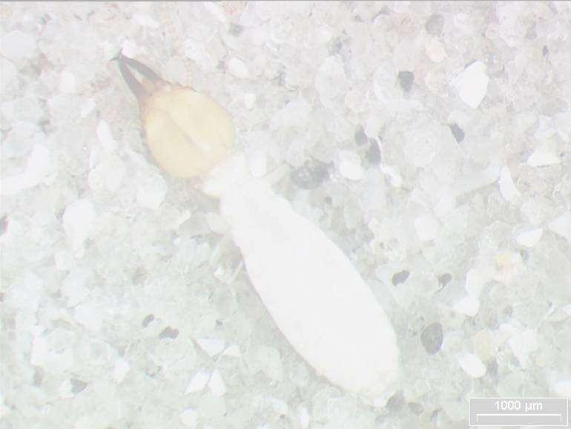

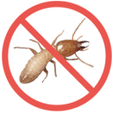

白蚁防治技术培训
主讲：佛山市白蚁防治行业协会秘书长 叶钦杰

Slide 2
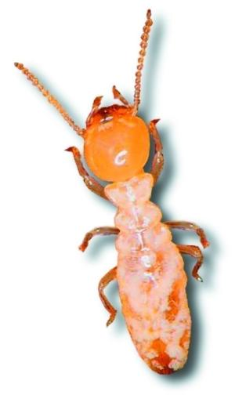
Termite Biology
白蚁生物学
Termite damages
白蚁的危害
Termite inspection
蚁情检查
Termite management strategies
白蚁防治策略

Slide 3
Termite Biology
白蚁生物学

Slide 4
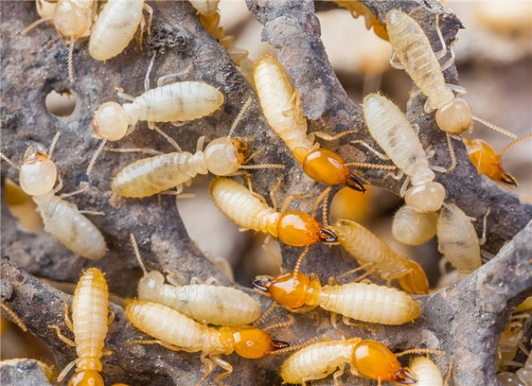
Termites? What are they?
白蚁?是什么?

Slide 5
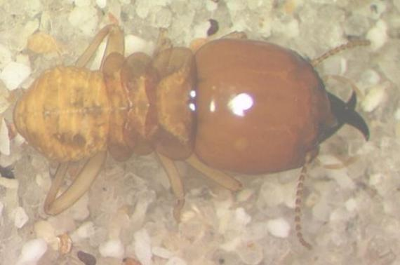

Termites? What are they?
白蚁?是什么?
Order: Blattodea 形态:蜚蠊目类昆虫 （原本为等翅目，2007年，等翅目撤销，被归入蜚蠊目）
Incomplete metamorphosis. 不完全变态
Feed on cellulose. 以纤维素为食
Common species: Coptotermes spp., Odontotermes spp.
一般种类:家白蚁属 土白蚁属
Destructive species, attacking buildings and wooden structures world-wide.
具破坏性的种类,破坏全球所有房屋和木质建筑物.
Can travel up to 100m, also affect top levels of multi-storey buildings.
同时也能破坏多层建筑物的顶层.

Slide 6
Termites? What are they?
白蚁?是什么?
Social insects-live in colonies and practice caste system.
群居的昆虫—群体生活、实行等级管理。
>2700 species of termites in the tropical and subtropical regions.
在热带和亚热带地区有超过2700种白蚁。
Food source: cellulose based materials, mainly wood.
食物来源：材料纤维素，主要是木材。
Play important role in nutrient recycling in the forest.
在森林的营养循环中扮演重要的角色。

Slide 7
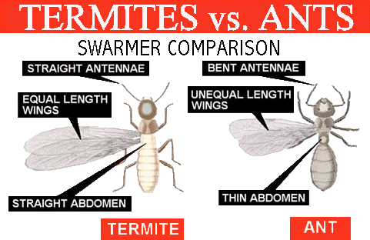
Termite vs Ant 白蚁对比蚂蚁
虫卵的比较
弯曲的触角
笔直的触角
同等长度
的翅膀
不同长度
的翅膀
瘦长的腹部
笔直的腹部
Notes:
People confuse termites and ants because of the similar social life.
Termite
Broad waists and straight (middle part of body not narrow), bead-like antennae, wings similar in shape, size and pattern - many small veins.
Ants
Antenna elbowed, middle part of body very narrow, wings not alike in shape, size, or pattern - few veins.

Slide 8
Caste system等级制度
Termites exist in a colony in several ‘forms’ or castes, each of which has particular structures and functions related to the survival and maintenance of the colony.
白蚁以不同等级群居，每一等级有其独特的结构和功能，这对白蚁生存和保护整个群体很重要。
There is division of labour between the different types of individuals
不同个体都有分工
    King 蚁王
    Queen 蚁后
    Alates (swarmer) 繁殖蚁
    Reproductives 补充繁殖蚁
    Soldiers 兵蚁
    Workers 工蚁

Slide 9
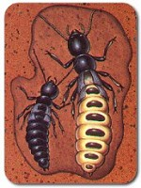
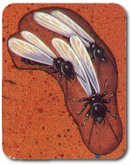
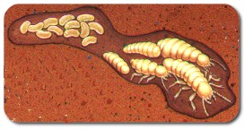
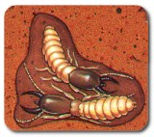
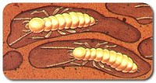
Caste system等级制度
Eggs &Nymph
卵和若蚁
Queen 蚁后
Winged Reproductives
长翅繁殖蚁
Workers 工蚁
Soldiers兵蚁

Slide 10
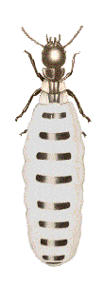
Caste system等级制度
The Queen蚁后
  The main purpose of the queen is reproduction.
  蚁后的主要功能是繁殖。
  During the early developmental period of the colony, the queen together with the king will tend her young until the workers are numerous enough to take over these nursery duties.
  在发展领地的早期阶段，蚁后和蚁王需照顾若蚁直到有足够的工蚁接替它们的照顾责任。
  First-form queen is usually long-lived and is fertilized by the king at intervals during this time.
  这段时间蚁后很长寿并不定期地与蚁王交配。

Slide 11
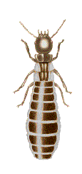
Caste system等级制度
The King 蚁王
  The original king along with the queen tends the young during the early life of the colony.
  在蚁巢发展前期蚁王与蚁后一并照顾幼虫。
  Fertilizes the queen from time to time and is long-lived.
  不停使蚁后授精且很长寿。

Slide 12

Caste system等级制度
Workers工蚁
  Constitute the greatest number of individuals in a colony.
  在蚁巢中是最大的组成部分。
  Do most of the work: gathering food, feeding the young, repairing damage, tending and feeding the queen.
  做更多的工作：收集食物，喂养幼虫，修补被损坏的地方，照顾喂养蚁后。
  Do not involved in reproduction and have no compound eyes.
  无生殖功能，复眼消失。
  Perform trophallaxis
  交哺

Slide 13
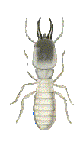
Caste system等级制度
Soldiers兵蚁
  They have larger and darker heads than the workers and have strong mandibles.
  它们的头部比工蚁更大更黑，有强大的下颚。
  Their reproductive organs have not developed.
  它们的生殖器官不发达。
  Blind, cannot eat must be fed by workers (trophallaxis).
  失明，需通过工蚁喂养。
  Main function is to defend the colony against invaders.
  主要功能是防止蚁巢受外来侵害。

Slide 14
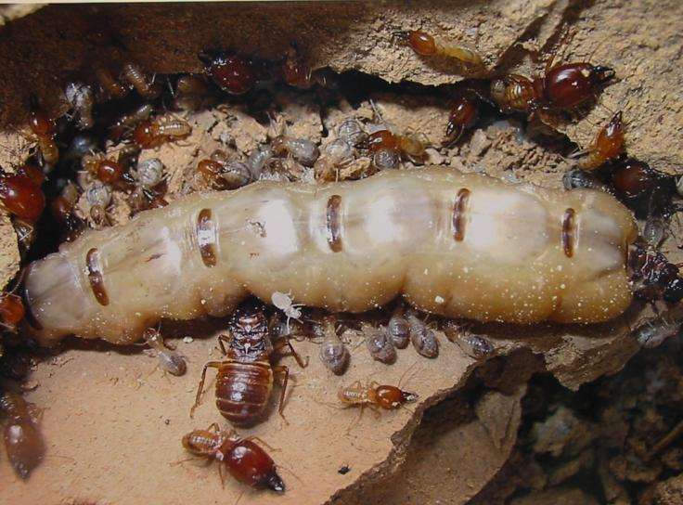
Termite Biology白蚁生物学

Slide 15
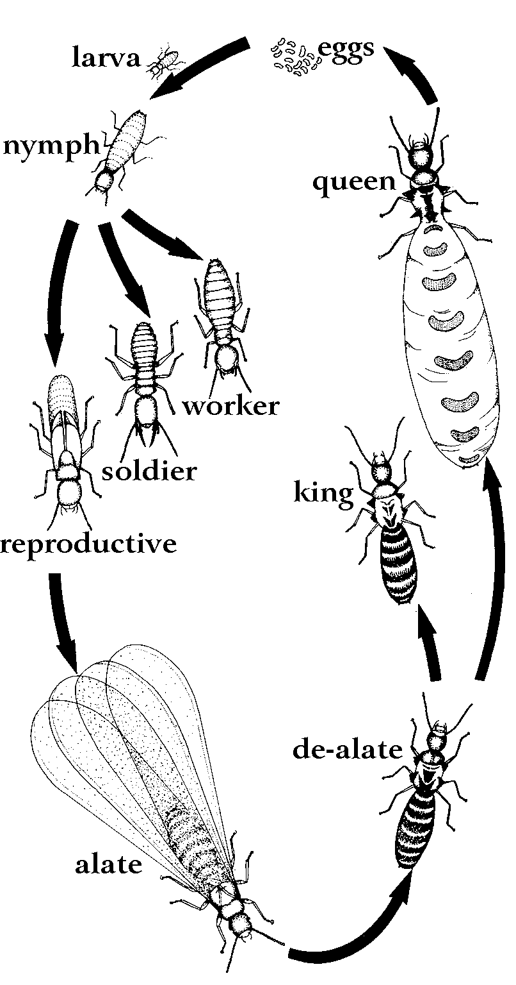
Life cycle生命周期
卵
幼蚁
若蚁
蚁后
工蚁
兵蚁
补充繁殖蚁
蚁王
脱翅型繁殖蚁
长翅型繁殖蚁

Slide 16
Life cycle生命周期
Develop through an incomplete metamorphosis.
不完全变态发展
Winged male and female adults will leave the nest during certain seasons of the year.
有翅膀的成年雄蚁和雌蚁每年某个特定季度会飞离蚁巢。
After a brief flight, the male and female termites pairs off either in flight or shortly after landing.
一次短暂的飞行后，雄蚁和雌蚁在飞行过程中和着陆后双翅脱落。
Surviving pair will make suitable nesting sites.
存活的一对白蚁在适当的地点筑巢。
Mating occurs after the pair had created and sealed the nest.
在筑巢和将蚁巢隐敝后白蚁开始交配。

Slide 17
Life cycle生命周期
The queen will lay a small batch of eggs.
蚁后产下一小批卵。
Nymphs undergo several moults and the first batch of eggs hatched develop into workers.
卵经历几次蜕变后第一批卵孵化成工蚁。
The other castes of termites develop from a later egg laying stage.
其他等级的白蚁则从后期的产卵产生。

Slide 18
Termite survival triangle
白蚁生存条件
Food食物
生存
Survival
Moisture 潮湿
Shelter 隐蔽

Slide 19
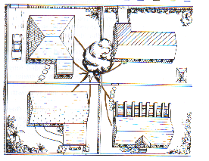
Subterranean termites土壤白蚁
Most subterranean termites make their passages underground, usually in the top 20 cm of soil
通常的土壤白蚁在地下20厘米的地方挖掘蚁道
Can make earthen shelter tubes up vertical surfaces
能够筑起垂直向上的土质蚁道
The range from the central colony
can be up to 50m, but varies
with species, type of soil
and available food sources
中心范围能够达到50米，
但因为种类的不同、土壤的类型和
食物水源的不同而改变

Slide 20
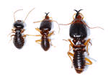
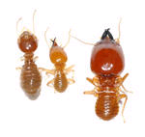
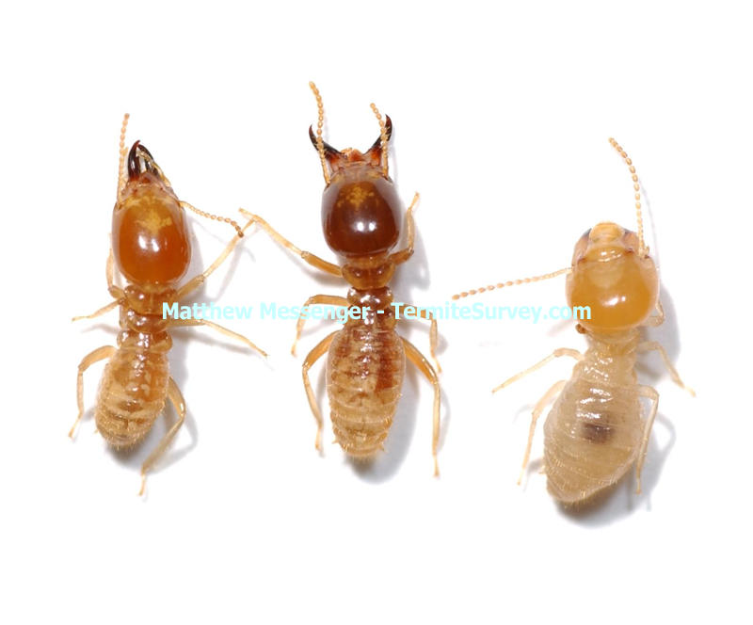
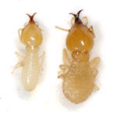
Subterranean termites土壤白蚁

Slide 21

Termite Biology 白蚁生物学
Order: isoptera 形态:蜚蠊目昆虫
Incomplete metamorphosis. 不完全变态
Feed on cellulose. 以纤维素为食
Caste system. 等级制度
Trophallaxis. 哺育
Survival triangle: food + moisture + shelter.
生存条件：食物+潮湿+隐蔽

Slide 22
Termite damages
白蚁的危害

Slide 23
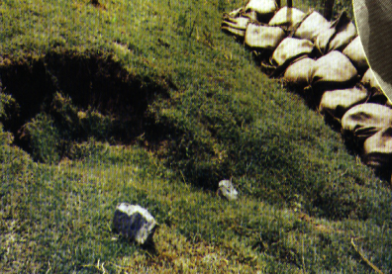
Termite Damages白蚁的损害
Damage and repair costs each year amount to more than US＄22 billion worldwide.
世界各地每年因白蚁造成的损害和修补费用高达220亿美元.
USA : ＄11 billion
美国:110亿美元
Japan : ＄ 800 million
日本:80亿美元
China: ＄ 350 million
中国:35亿美元
Australia: ＄ 200 million
澳大利亚:20亿美元

Slide 24
Distribution of O. formosanus in China
中国:35亿美元

Slide 25
Areas most prone to termite attack
白蚁经常破坏的地方
Door and window frames. 门、窗框
Built in cabinets. 壁橱
Base-board skirting.护壁板及踢脚板
Store rooms. 储藏室
Roofing materials.屋顶
Parquet floors.木地板

Slide 26
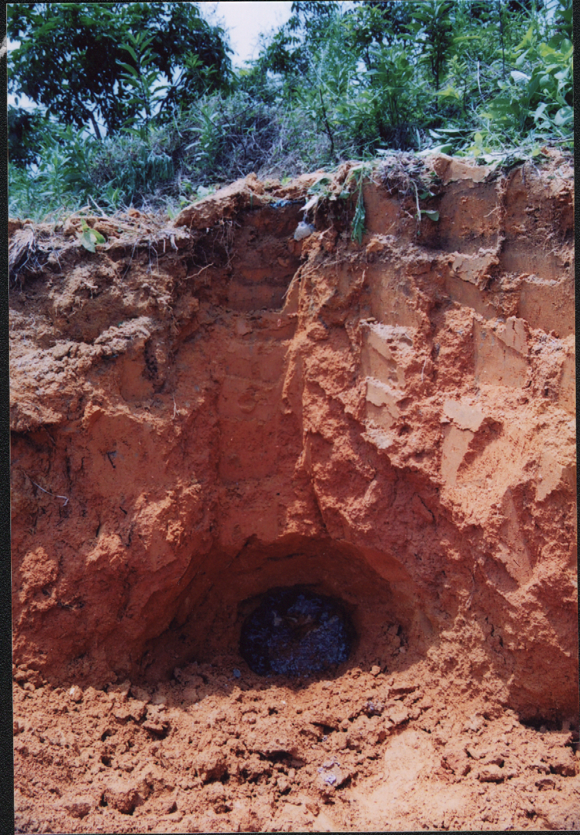
Termite damages白蚁的损害

Slide 27
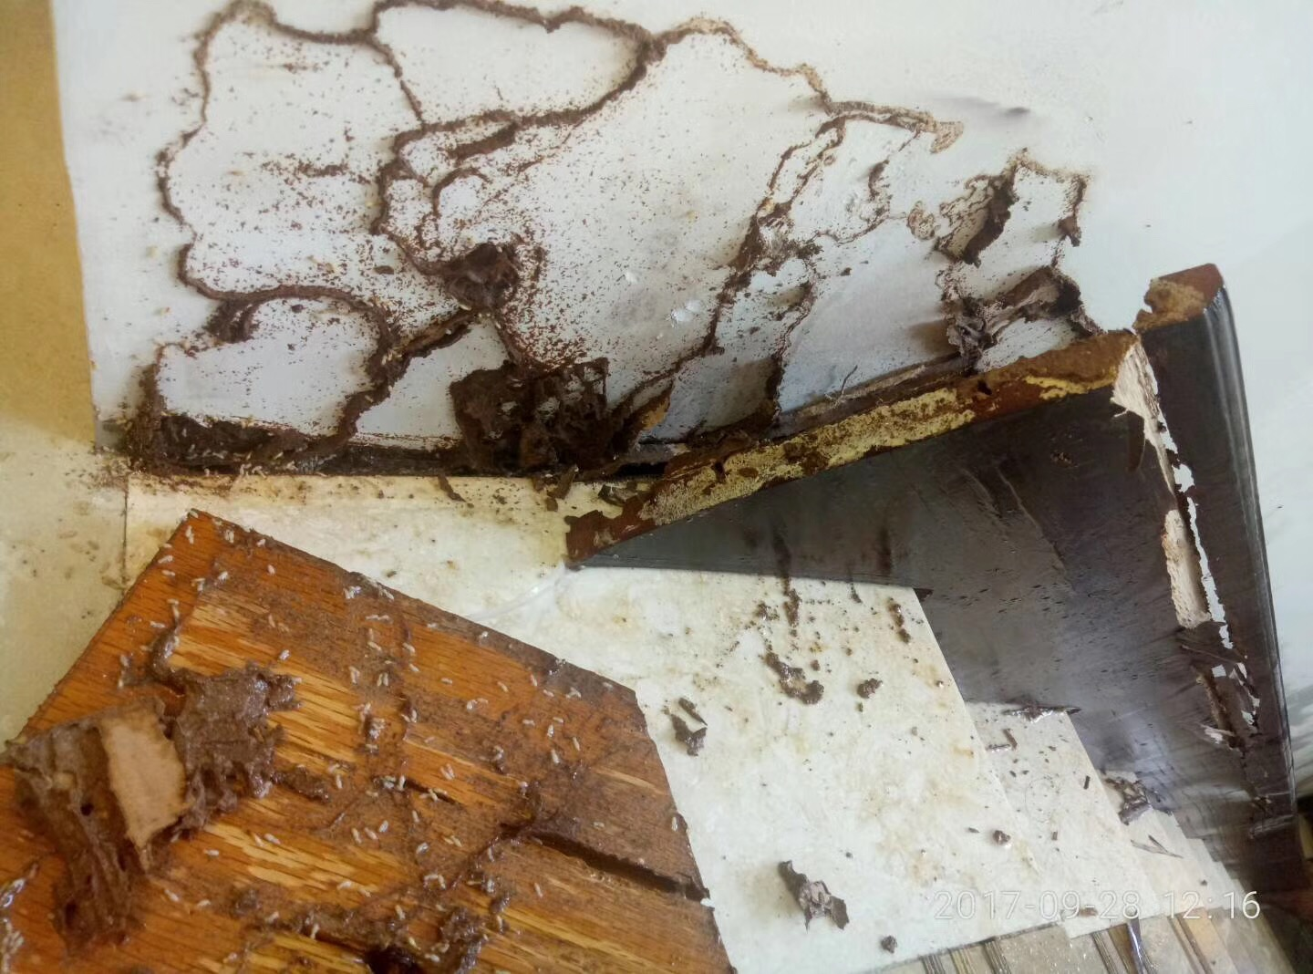
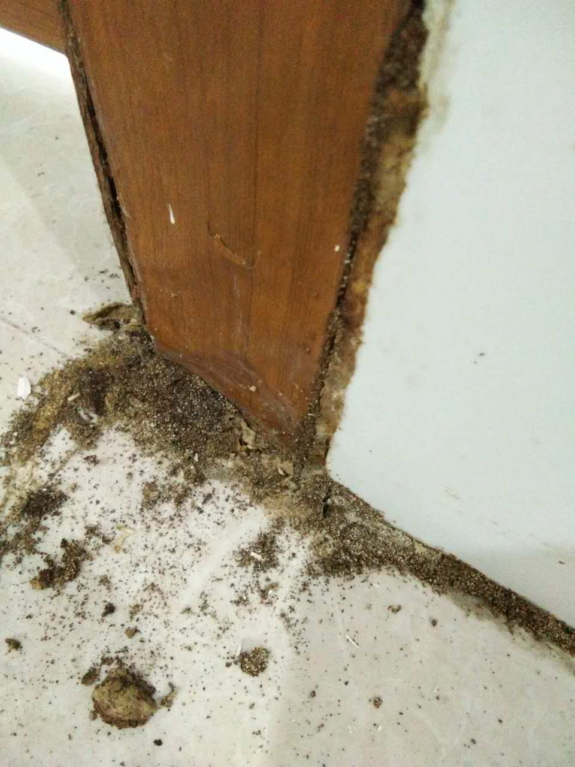
Termite damages白蚁的损害

Slide 28
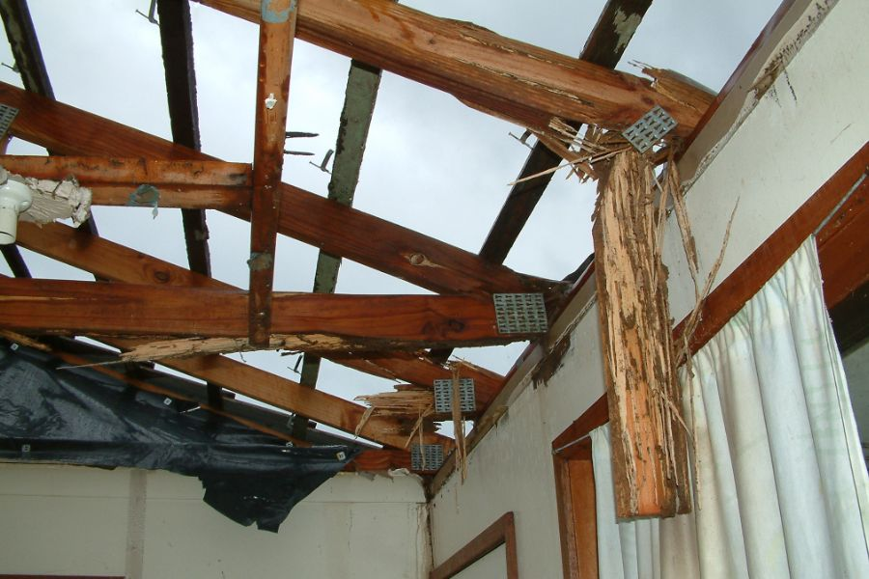
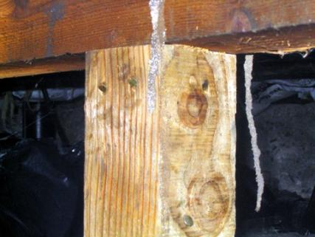
Termite damages白蚁的损害

Slide 29
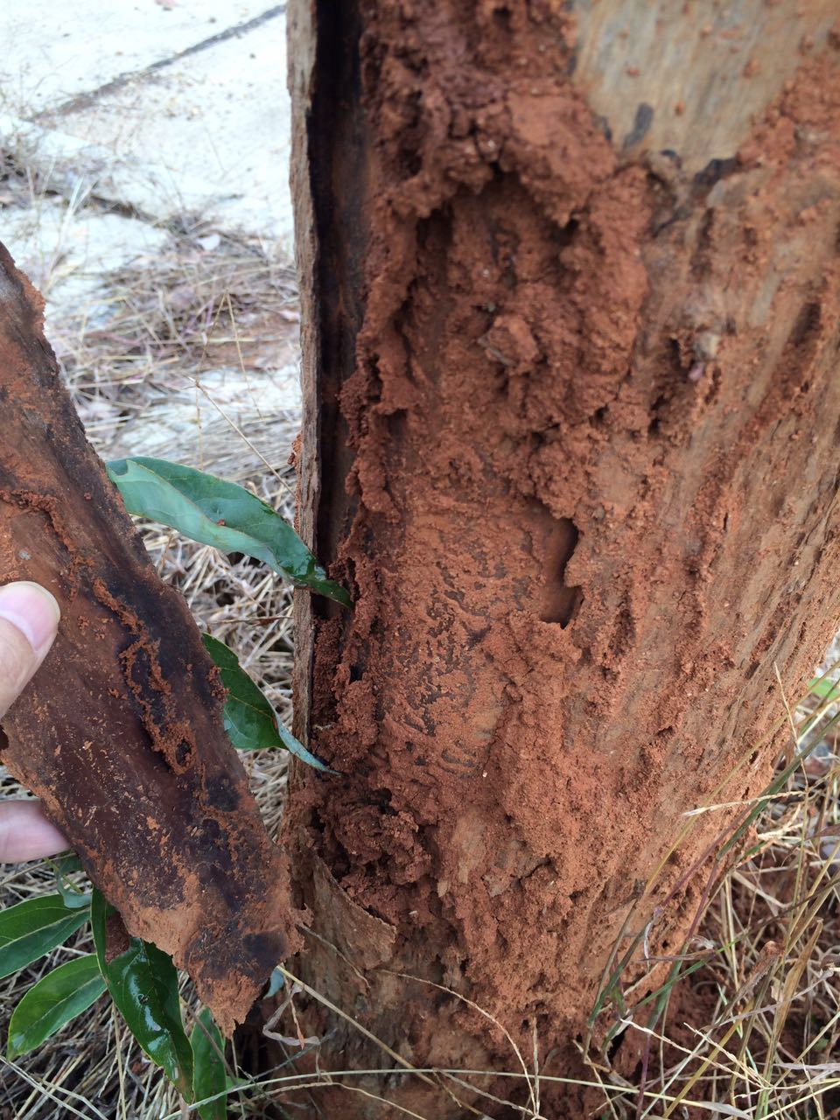
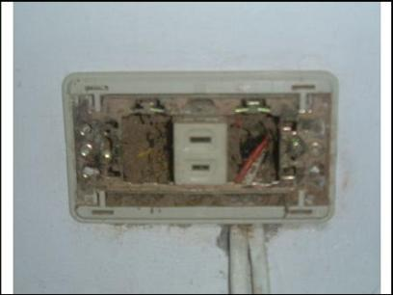
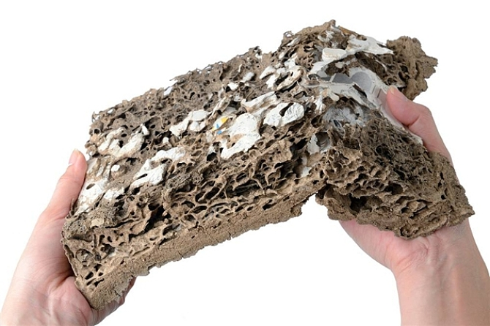
Termite damages白蚁的损害

Slide 30
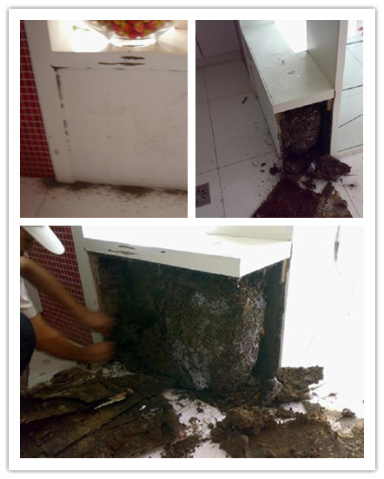
Termite damages白蚁的损害

Slide 31
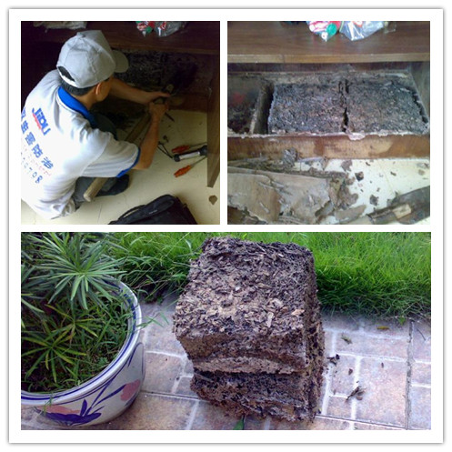
Termite damages白蚁的损害

Slide 32
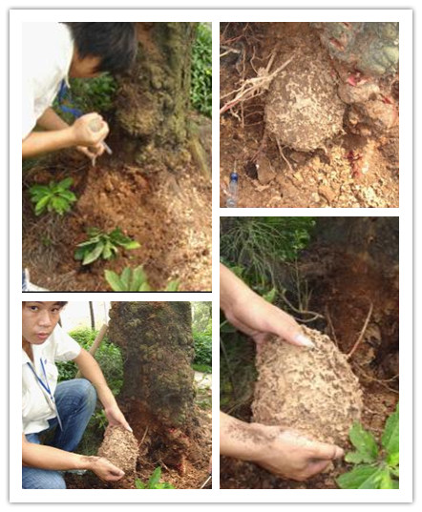
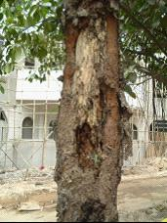
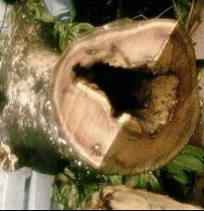
Termite damages白蚁的损害

Slide 33
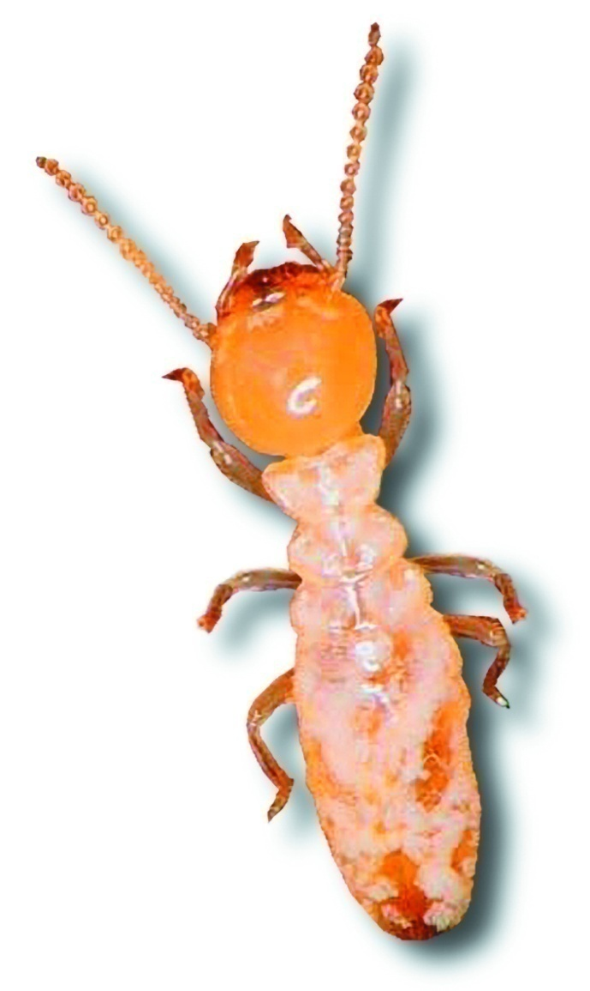
Termite inspection
蚁情检查

Slide 34
A Word Of Caution….警示
Termite control is challenging. 白蚁控制具有挑战性。
Successful termite control begins with a thorough competent termite inspection. 成功控制白蚁来源于一次彻底的蚁情检查。
  Termites are not easy to detect 蚁情检查不是易事。
  Only 25-35% of the structure is accessible for inspection 建筑物中只有25-35%能够被检查到。

Slide 35
Termite inspection
蚁情检查
Aim of a termite inspection to determine: 决定蚁情检查的目标
  the location of all areas of termite activity 白蚁活动范围的所有地方
  the point(s) of entry into the structure 白蚁进入建筑物的点
  potential areas for re-infestation 白蚁可能再侵袭的地方
  the potential nest sites 蚁巢的可能位置
  the areas posing difficulties or limitations for treatment 有障碍或难以处理的地方

Slide 36
Termite inspection
蚁情检查
An inspector must have a good knowledge of the following:
检查者必须具备以下常识:
  termite biology and behaviour 白蚁的生物学和习性
  treatment practices 操作经验
  building construction 建筑理论

Slide 37
Termite inspection
蚁情检查
  conducive conditions (e.g. moisture, wood-to-ground contact, inadequate ventilation)
  有益条件（如湿气、连接地面的木板、不通风）
  location of expansion joints, settlement cracks, plumbing, and other slab entries
  伸缩接头、沉降裂缝、铅管和其他厚平板入口的地点
  location of features complicating treatment, such as ponds, drainage systems, air-conditioning ducts, electrical wiring
  复杂地点特征，如池塘、排水系统、空调管、电线
  Treatment specifications 处理说明

Slide 38
Termite Identification
蚁情鉴定
Try to determine the termite species.
试图确定白蚁的种类
Sometimes their characteristic behaviour will assist you in identifying.
有时它们的习性能帮助你分辨它们的种类
    further sites of infestation 白蚁出没的地点
    potential sites of entry 潜在的入口
    best plan for treatment 处理的最好方案

Slide 39
General Inspection Guidelines
普通检查指南
When activity is discovered: 当发现白蚁的活动地点
  take great care not to disturb the workings 不要打扰白蚁的活动
  make all attempts to trace back the termites to the entry point or nest.
  试图找到通向蚁巢的痕迹

Slide 40
Termite inspection
白蚁检查
  the location of all areas of termite activity 白蚁活动范围的所有地方
  the point(s) of entry into the structure 白蚁进入建筑物的定点
  potential areas for re-infestation 白蚁可能再侵袭的地方
  the potential nest sites 蚁巢的可能方位
  the areas posing difficulties or limitations for treatment 有障碍或难以处理的地方
  The use of termite inspection tools.
  白蚁检查工具的使用
  永远不要假设,永远都要检查!!!

Slide 41
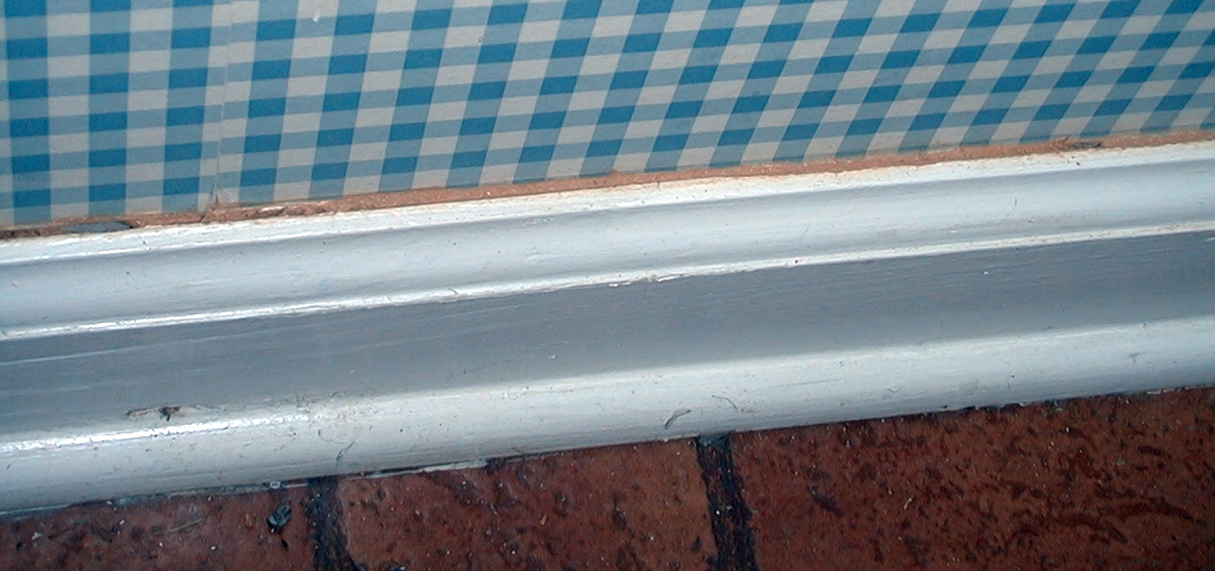
It may start with a tiny trail…
从微小的痕迹开始
But we still need to look closer!
我们还是要仔细查看！

Slide 42
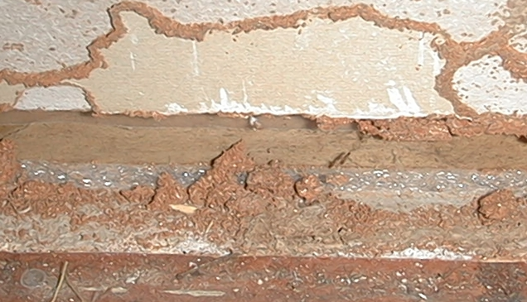
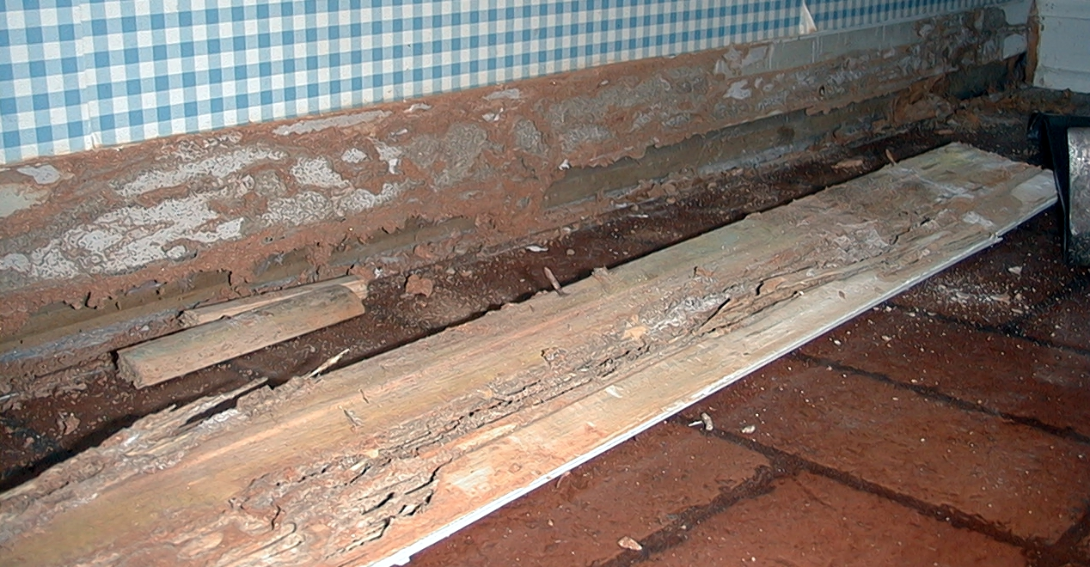
Damage can be more extensive than it first appeared
损害可能远远比刚发现时更严重

Slide 43
Termite management strategies
白蚁防治策略

Slide 44
Termite management strategies
白蚁防治策略
Termite management白蚁防治
Conventional
常规
Repellent
Termiticide
驱避性
白蚁剂
Non-repellent
Termiticide
非驱避性
白蚁剂
Non-conventional
非常规
Biological
Control
生物控制
Physical
Control
物理控制
Baiting
诱饵

Slide 45
Conventional methods 常规方法
Termite management - heavily relies on chemicals.
白蚁防治- 化学防治
Soil termiticide treatment creates chemical barrier that excludes subterranean termites from buildings and structures.
应用毒土驱白蚁剂可以产生化学障碍使地下的白蚁远离建筑物。
Has been the most popular method for the past 50 years.
这种方法是过去50年最受欢迎的方法。

Slide 46
Termite management strategies
白蚁防治策略
Termite management白蚁防治
Conventional
常规
Repellent
Termiticide
驱避性
白蚁剂
Non-repellent
Termiticide
非驱避性
白蚁剂
Non-conventional
非常规
Biological
Control
生物控制
Physical
Control
物理控制
Baiting
诱饵

Slide 47
Repellent termiticides驱白蚁剂
In the past, repellent termiticides were widely used.
在过去，驱白蚁剂被广泛运用。
Chlordane was used to prevent or eliminate termites during the 1950’s, 1960’, 1970’s and 1980’s.
在1950、1960、1970和1980年代，强力杀虫剂也被应用于驱除白蚁。
Chlorpyrifos then became available in 1980.
毒死蜱在1980年代也相继面世。
Organophosphates and pyrethroids are currently marketed as termiticides.
有机磷和拟除虫菊酯目前在市场上被应用为驱白蚁剂。

Slide 48
Repellent termiticides 驱白蚁剂
Bifenthrin 联苯菊酯
Permethrin 氯菊酯
Cypermethrin 氯氰菊酯
Chlorpyrifos 毒死蜱

Slide 49
Termite management strategies
白蚁防治策略
Termite management白蚁防治
Conventional
常规
Repellent
Termiticide
驱白蚁剂
Non-repellent
Termiticide
非驱避性
白蚁剂
Non-conventional
非常规
Biological
Control
生物控制
Physical
Control
物理控制
Baiting
诱饵

Slide 50
Non-repellent termiticides
非驱避性白蚁剂
Non-repellent termiticides have slowly gained their popularity.
非驱避性白蚁剂已逐渐受欢迎。
Termites will not be able to detect the presence of the treated termiticide in soil.
白蚁无法发觉土壤里施用白蚁剂。
These compounds also have a delayed mode of action.
这种化合物也同样具备滞留效用。
Termites will continue to forage freely.
白蚁还将继续自由觅食。
Termites pick up the active ingredient while foraging, and transfer the active ingredient to the colony members.

Slide 51
Non-repellent termiticides
非驱避性白蚁剂
Fipronil 氟虫腈
Imidacloprid 吡虫啉
Chlorfenapyr 虫螨腈

Slide 52
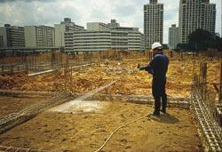
Pre-construction treatment
建筑施工前防治

Slide 53
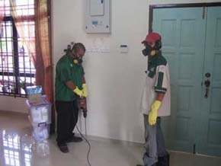
Post-construction treatment
建筑施工后防治

Slide 54
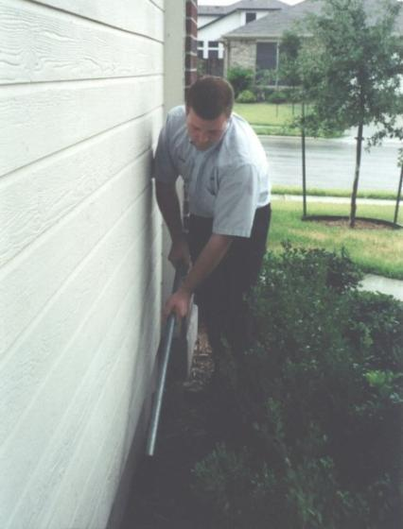
Trenching 挖沟

Slide 55
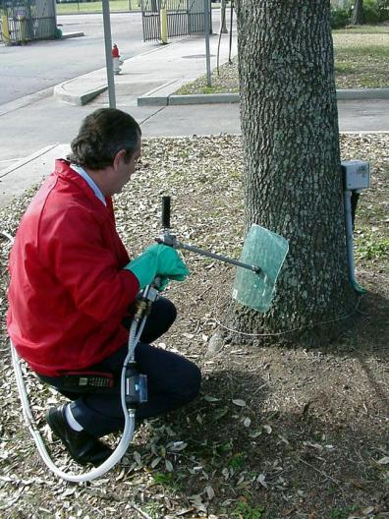
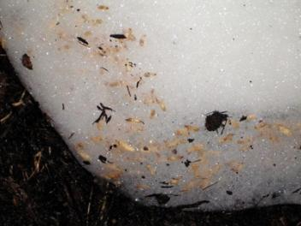
Termiticide foam 注射白蚁剂泡沫

Slide 56
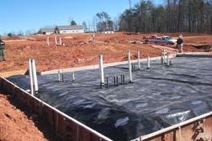
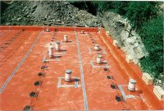
Termite Blocker
物理阻隔白蚁

Slide 57
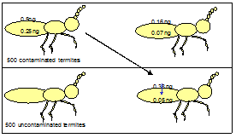
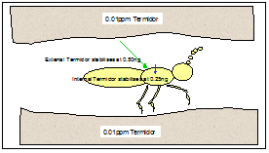
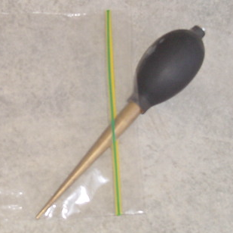
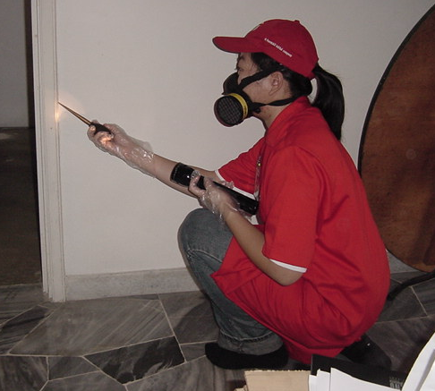


Spot treatment
定点处理

Slide 58

Termguard Reticulation System
长期保护网系统

Slide 59
Termite management strategies
白蚁防治策略
Termite management白蚁防治
Conventional
常规
Repellent
Termiticide
驱白蚁剂
Non-repellent
Termiticide
非驱避性
白蚁剂
Non-conventional
非常规
Biological
Control
生物控制
Physical
Control
物理控制
Baiting
诱饵

Slide 60




Biological control 生物控制
Fungi: Beauvaria sp., Metarhizium sp.
真菌类:
Nematode: Steinernema sp.
线虫类:
BioBlast®.
细胞

Slide 61
Termite management strategies
白蚁防治策略
Termite management白蚁防治
Conventional
常规
Repellent
Termiticide
驱白蚁剂
Non-repellent
Termiticide
非驱避性
白蚁剂
Non-conventional
非常规
Biological
Control
生物控制
Physical
Control
物理控制
Baiting
诱饵

Slide 62
Physical control
物理控制
Particle size vs termite body size. 间距与白蚁体型对比。
Gaps: too small for termites to get through.
间距：很小的间距使白蚁无法通过。

Slide 63


Basaltic Termite Barrier
玄武岩白蚁屏障

Slide 64
TermiMesh 防白蚁钢网

Slide 65
Termite management strategies
白蚁防治策略
Termite management白蚁防治
Conventional
常规
Repellent
Termiticide
驱白蚁剂
Non-repellent
Termiticide
非驱避性
白蚁剂
Non-conventional
非常规
Biological
Control
生物控制
Physical
Control
物理控制
Baiting
诱饵

Slide 66




Baiting
诱饵

Slide 67


Baiting
诱饵

Slide 68
Baiting
诱饵
Exploit termite’s nature behaviour – trophallaxis.
利用白蚁的习性-交哺
Hexaflumuron.氟铃脲
Diflubenzuron.除虫脲
Noviflumuron.多氟脲
Bistrifluron.双三氟虫脲

Slide 69
Termite Biology
白蚁生物学
Termite damages
白蚁的危害
Termite inspection
蚁情检查
Termite management strategies
白蚁防治策略
白蚁是一种危害性很大的昆虫，如果在家中发现白蚁，建议要请专业人士来清除。

Slide 70



Thank You
谢谢！
主讲人：叶钦杰 联系电话:13702422221
佛山市白蚁防治行业协会 秘书长
广东省白蚁学会 监事
南海区有害生物防制行业协会 副会长
即扑有害生物防控技术有限公司 总经理

